Slide 1
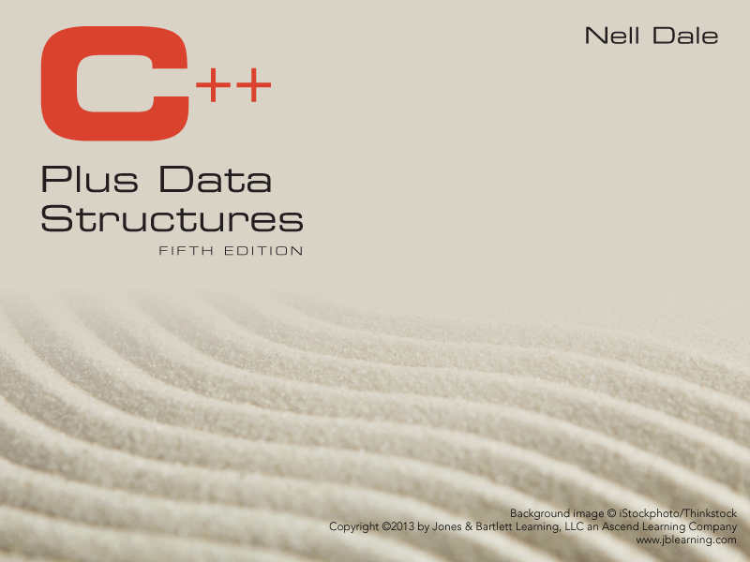
Chapter 1
Software Engineering Principles
Chapter 1 - Software Engineering Principles

Slide 2
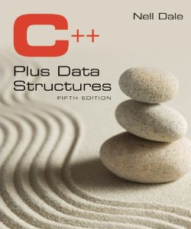
Lecture 2
Notes:
This chapter provides an overview of computer security. We begin with a discussion of what we mean by computer security. In essence, computer security deals with computer-related assets that are subject to a variety of threats and for which various measures are taken to protect those assets. Accordingly, the next section of this chapter provides a brief overview of the categories of computer-related assets that users and system managers wish to preserve and protect, and a look at the various threats and attacks that can be made on those assets. Then, we survey the measures that can be taken to deal with such threats and attacks. This we do from three different viewpoints, in Sections 1.3 through 1.5 . We then look at some recent trends in computer security and lay out in general terms a computer security strategy.

Slide 3
Software Engineering
A disciplined approach to the design, production, and maintenance of computer programs
that are developed on time and within cost estimates,
using tools that help to manage the size and complexity of the resulting software products
Chapter 1 - Software Engineering Principles

Slide 4
Software Life Cycles
Problem analysis understand the problem
Requirements definition specify what program will do
High- and low-level design how it meets requirements
Implementation of design code it
Testing and verification detect errors, show correct
Delivery turn over to customer
Operation use the program
Maintenance change the program

Slide 5
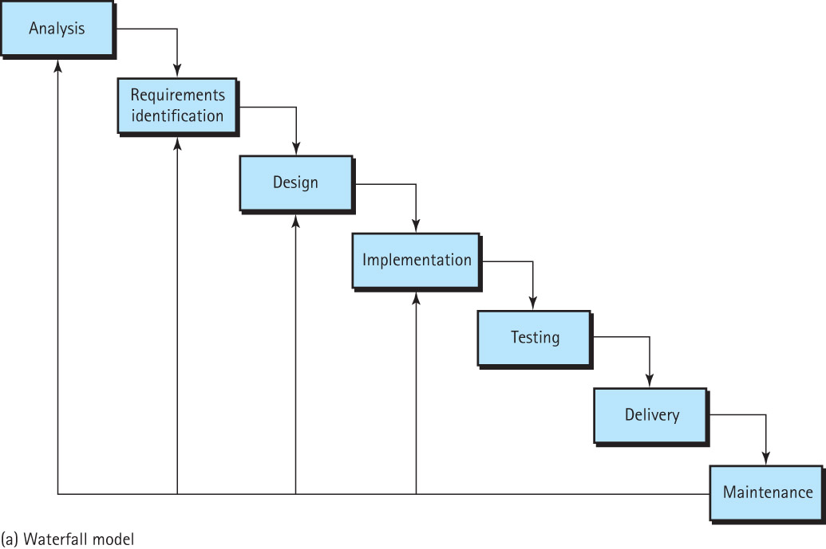
Waterfall Model
Chapter 1 - Software Engineering Principles

Slide 6
Waterfall Model
Linear Sequential Model
Advantages
  Simple and easy to understand
  Easy to manage
  Phases do not overlap
  Best for small projects (where the requirements are well understood)
Chapter 1 - Software Engineering Principles

Slide 7
Waterfall Model
Disadvantages
  Does not allow to go back and change
  Risks and uncertainties
  Not suitable for complex projects
  No working software until late stages of the cycle
Chapter 1 - Software Engineering Principles

Slide 8
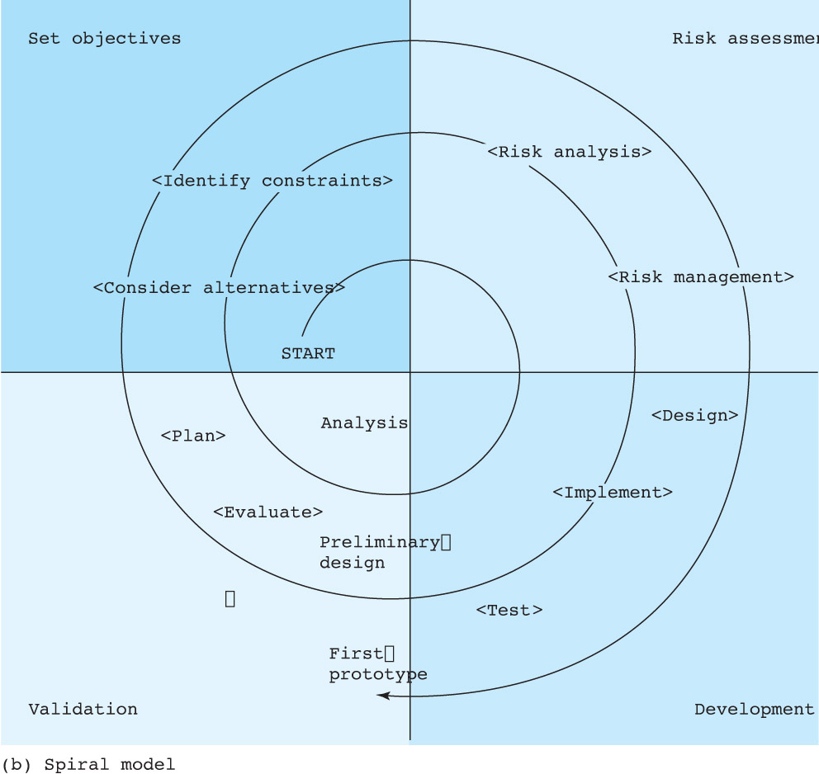
Spiral Model
Chapter 1 - Software Engineering Principles

Slide 9
Spiral Model
Risk reduction
Functionality can be added
Software produced early
Chapter 1 - Software Engineering Principles

Slide 10
An Algorithm Is . . .
A logical sequence of discrete steps that describes a complete solution to a given problem computable in a finite amount of time
Chapter 1 - Software Engineering Principles

Slide 11
Programmer ToolBoxes
Hardware
  the computers and their peripheral devices
Software
  operating systems, editors, compilers, interpreters, debugging systems, test-data generators, and so on
Ideaware
  shared body of knowledge that programmers have collected over time This contains algorithms & data structures for solving programming problems
Chapter 1 - Software Engineering Principles

Slide 12
Goals of Quality Software
It works
It can be modified without excessive time and effort
It is reusable
It is completed on time and within budget
Chapter 1 - Software Engineering Principles

Slide 13
Specification:
Understanding the Problem
Detailed Program Specification
Tells what the program must do, but not how it does it.
Is written documentation about the program.

Slide 14
Writing Detailed Specifications
Detailed Program Specification Includes:
Inputs
Outputs
Processing requirements
Assumptions

Slide 15
Program Design
Once you have fully clarified goals of the program, you can begin to develop a strategy for meeting them.
Ideaware tools used for software design
  Abstraction
  Information hiding
  Stepwise Refinement
  Visual tools
Chapter 1 - Software Engineering Principles

Slide 16
Abstraction
A model of a complex system that includes only the details essential to the perspective of the viewer of the system
An aid to manage complexity
Programs are abstractions
Chapter 1 - Software Engineering Principles

Slide 17
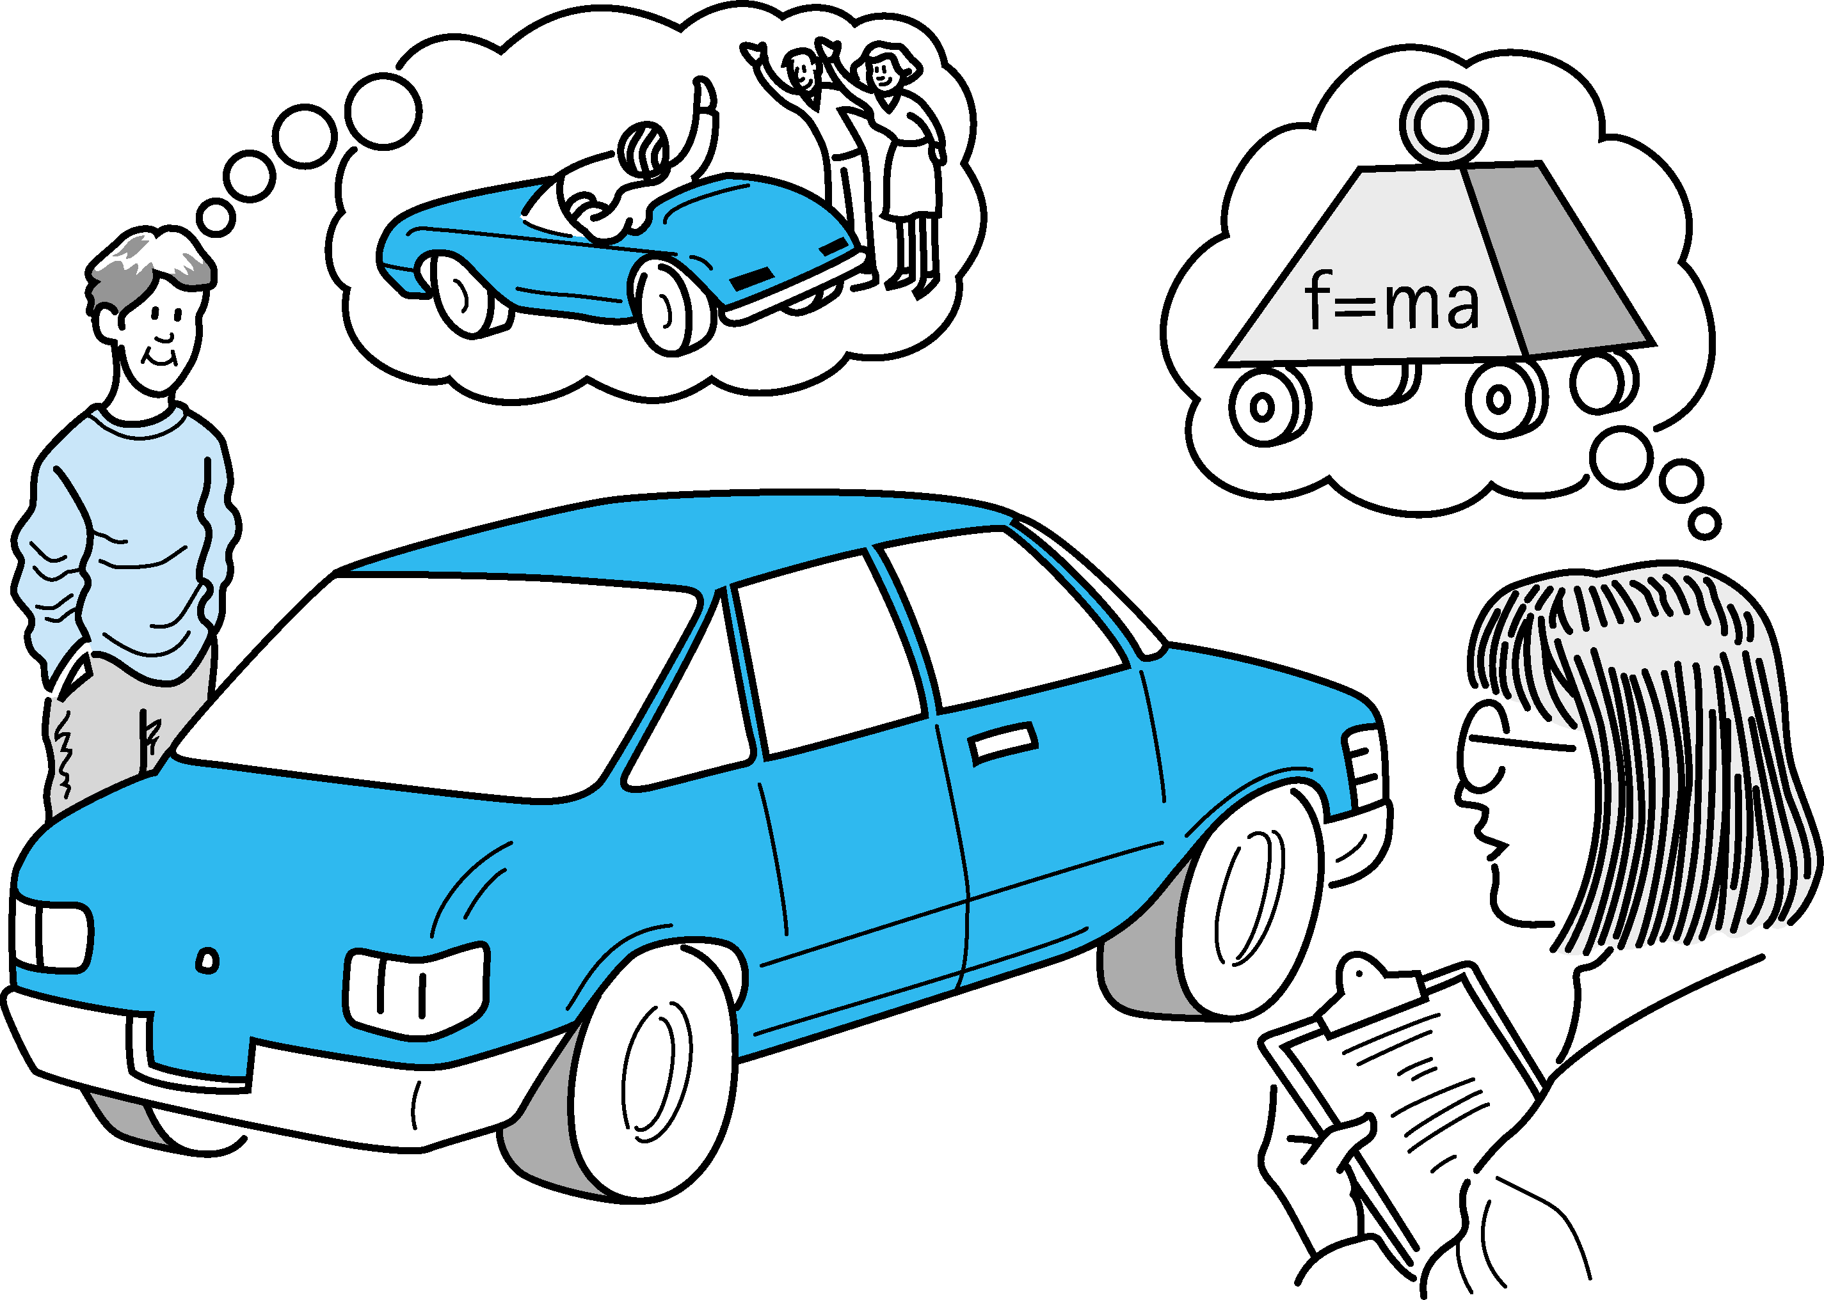
Abstraction (cont.)
Chapter 1 - Software Engineering Principles

Slide 18
Information Hiding
The practice of hiding the details of a module with the goal of controlling access to the details from the rest of the system
A programmer can concentrate on one module at a time
Each module should have a single purpose or identity
Chapter 1 - Software Engineering Principles

Slide 19
Stepwise Refinement
A problem is approached in stages
  Similar steps are followed during each stage, with the only difference being the level of detail involved
Chapter 1 - Software Engineering Principles

Slide 20
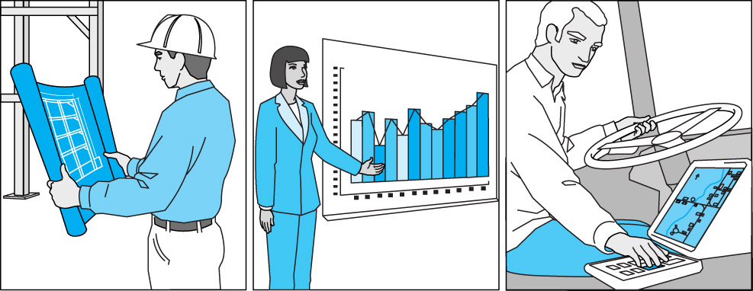
Visual Tools
Architects use blueprints, investors use market trend graphs, truck drivers use maps.
Software Engineers use different types of diagrams such as UML & CRC (Class, Responsibility and Collaboration) cards
Chapter 1 - Software Engineering Principles

Slide 21
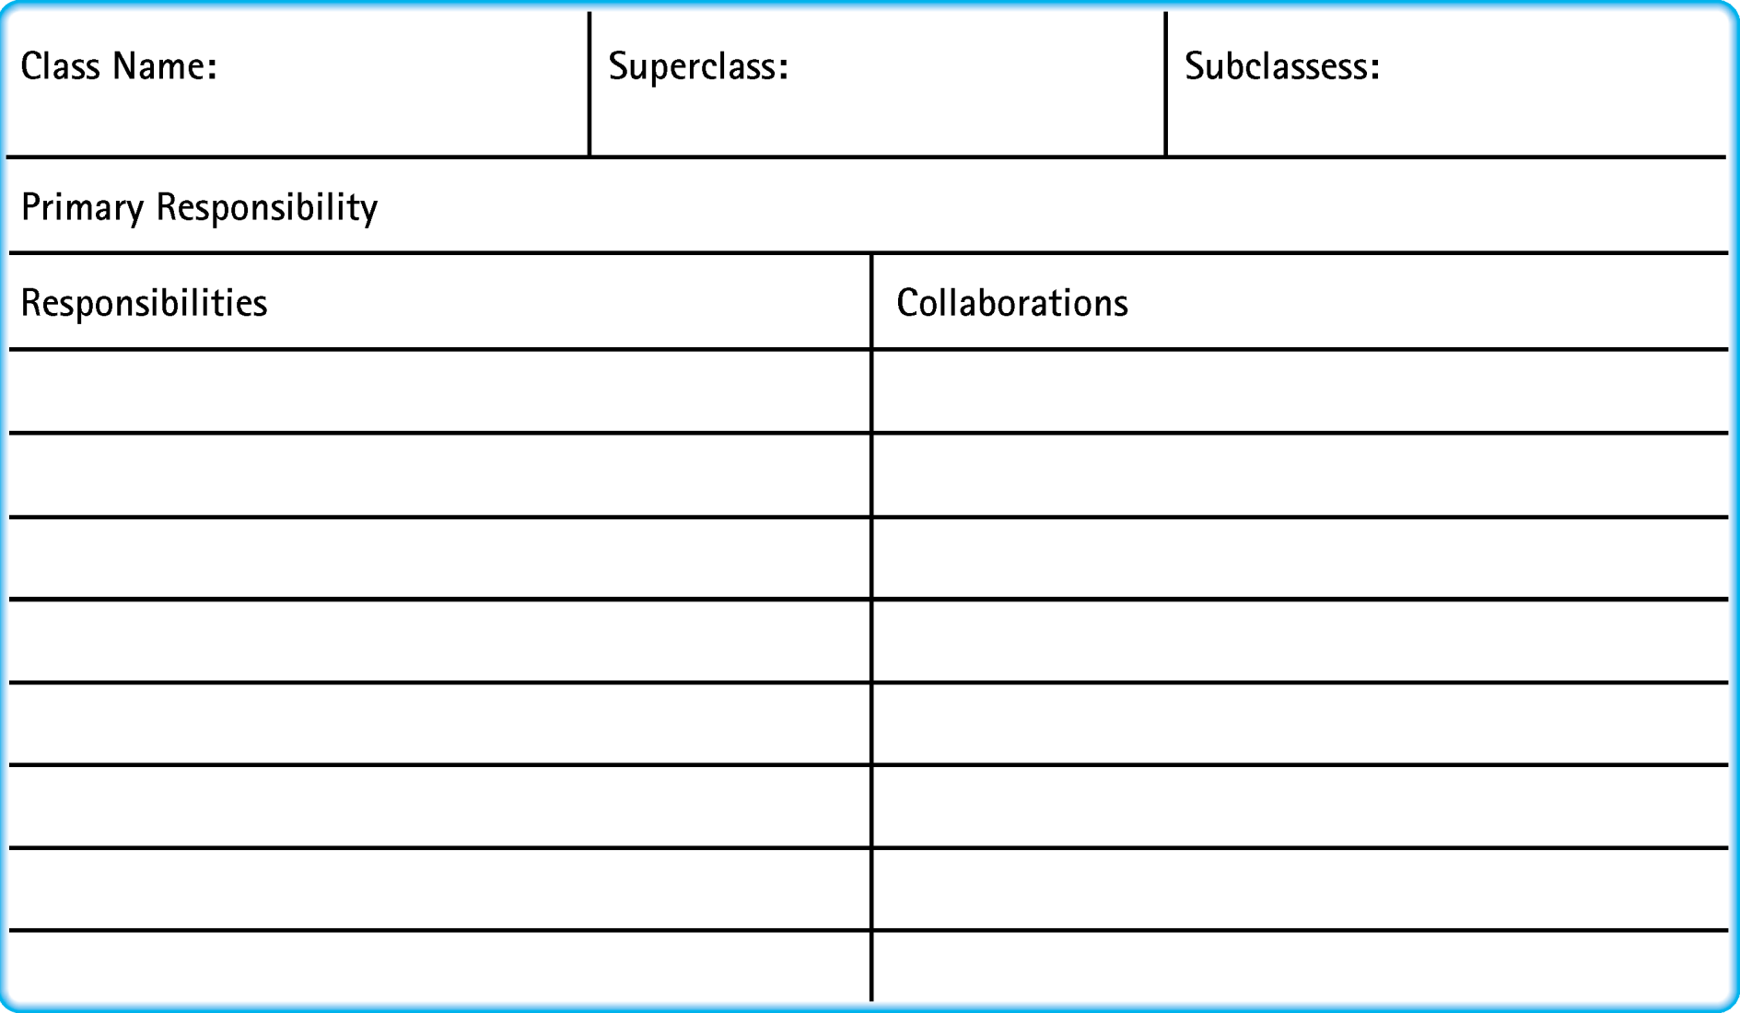
Visual Aids – CRC Cards
Chapter 1 - Software Engineering Principles

Slide 22
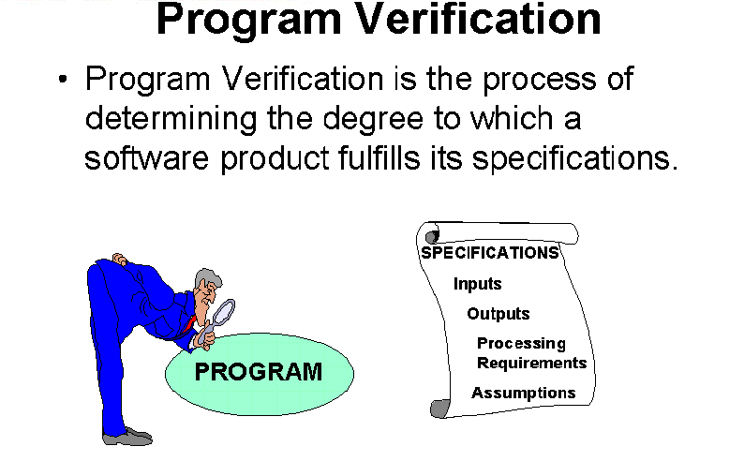
Verification
Chapter 1 - Software Engineering Principles

Slide 23
Verification of Software Correctness
Testing: The process of executing a program with data sets
Debugging: The process of removing known errors
Acceptance Test: The process of testing the system in its real environment with real data
Regression Testing: Reexecution of program tests after modifications have been made
Chapter 1 - Software Engineering Principles

Slide 24
Types of Errors
Specification
Design
Coding
Input
Chapter 1 - Software Engineering Principles

Slide 25
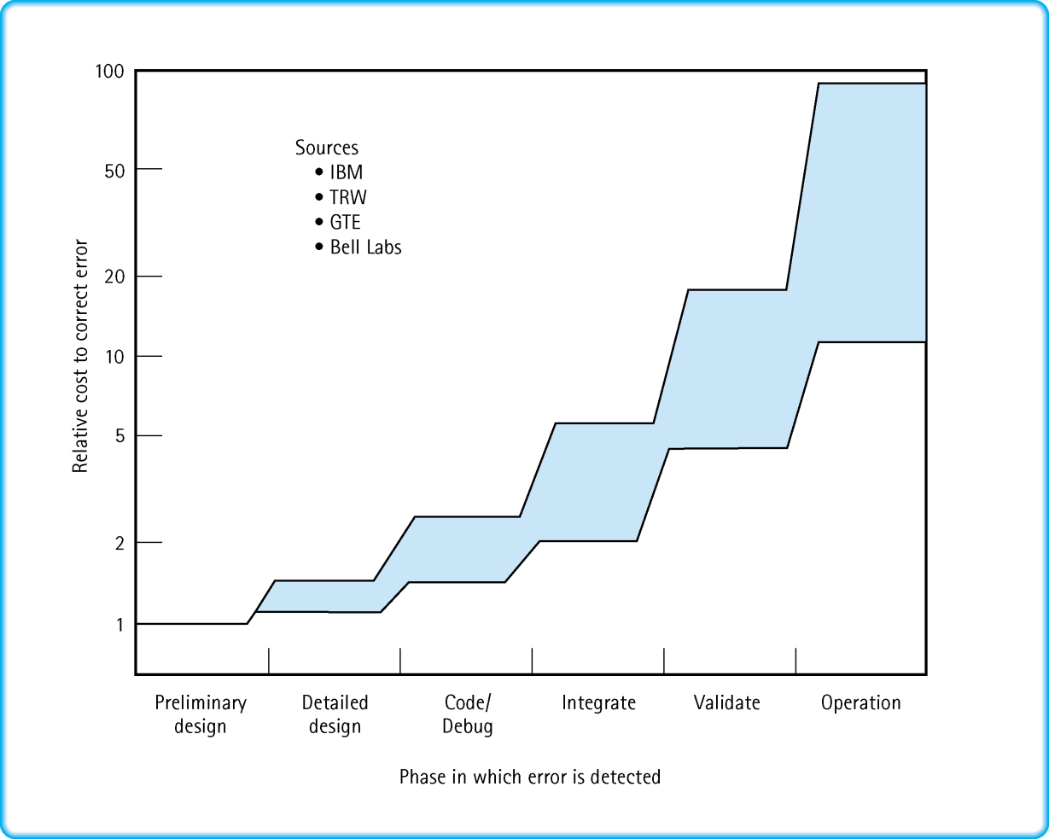
Cost of a Specification Error Based on When It Is Discovered
Chapter 1 - Software Engineering Principles

Slide 26
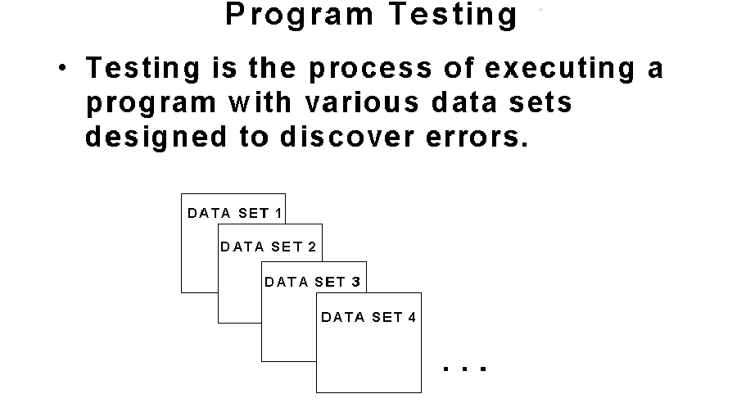
Program Testing
Chapter 1 - Software Engineering Principles

Slide 27
Program Testing (con't)
For Each Test Case:
  determine inputs
  determine the expected behavior of the program
  run the program and observe the resulting behavior
  compare the expected behavior and the actual behavior
Chapter 1 - Software Engineering Principles

Slide 28
Types of Testing
Unit testing: Testing a class or function by itself
Black-box testing: Testing a program or function based on the possible input values,
  treating the code as a “black box”
Clear (white) box testing: Testing a program or function based on covering all of the branches or paths of the code
Chapter 1 - Software Engineering Principles

Slide 29
Test Plans
Document showing the test cases planned for a program or module, their purposes, inputs, expected outputs, and criteria for success
For program testing to be effective, it must be planned
Chapter 1 - Software Engineering Principles

